Slide 1
Earth & Space Science
FCAT prep-Wednesday’s word
Quiz #4

Slide 2
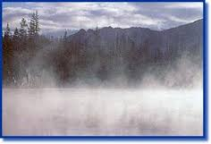
The process by which water changes from a liquid to a gas or vapor.

Slide 3
Evaporation
The process by which water changes from a liquid to a gas or vapor.

Slide 4
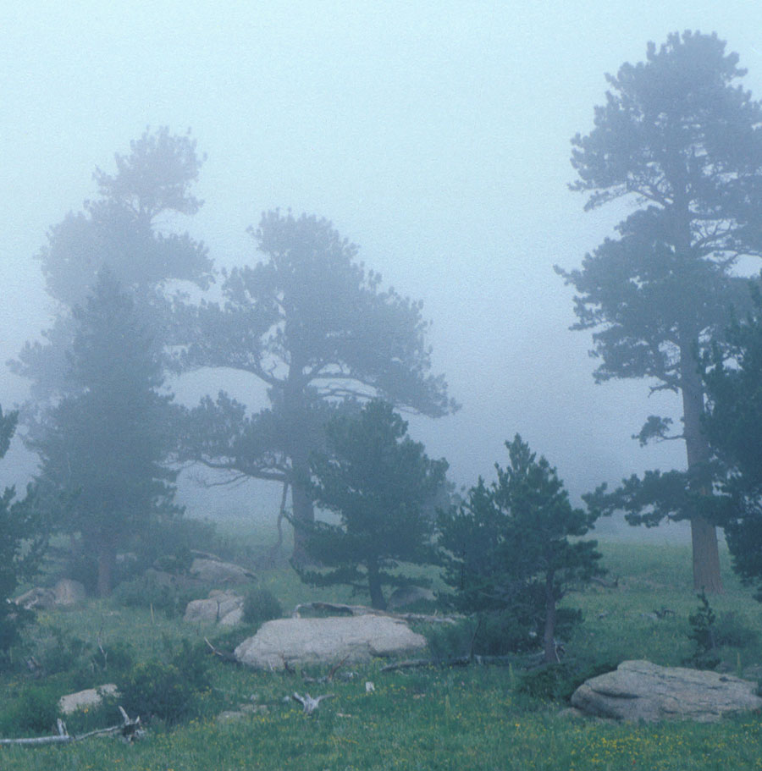
The amount of water vapor in the air. Water vapor is the gaseous state of water and is invisible.

Slide 5
Humidity
The amount of water vapor in the air. Water vapor is the gaseous state of water and is invisible.

Slide 6
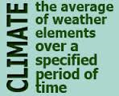

Slide 7
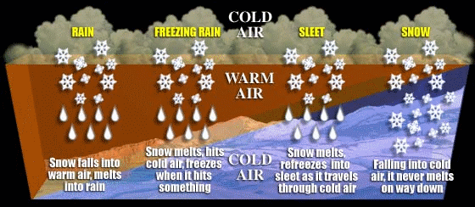
The state of the atmosphere with respect to wind, temperature, cloudiness, moisture, pressure, etc.

Slide 8
weather
The state of the atmosphere with respect to wind, temperature, cloudiness, moisture, pressure, etc.

Slide 10
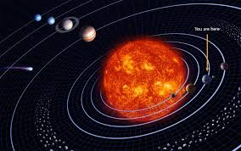
The definition of a revolution is the movement of one object around a center or another object.

Slide 11
revolution
The definition of a revolution is the movement of one object around a center or another object.

Slide 12
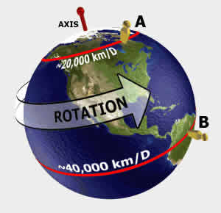
The action of rotating around an axis or center.

Slide 13
rotation
The action of rotating around an axis or center.

Slide 14
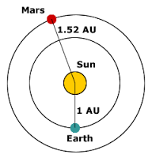
The mean distance from the center of the earth to the center of the sun.

Slide 15
A.U. (Astronomical Unit)
The mean distance from the center of the earth to the center of the sun.

Slide 16
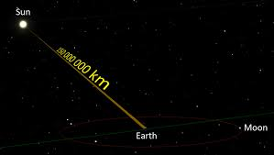
A unit of astronomical distance equivalent to the distance that light travels in one year.

Slide 17
Light-Year
A unit of astronomical distance equivalent to the distance that light travels in one year.

Slide 18
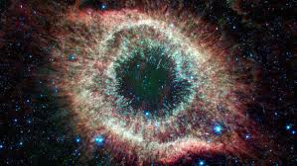
A cloud of gas and dust in outer space.

Slide 19
Nebula
A cloud of gas and dust in outer space.

Slide 20
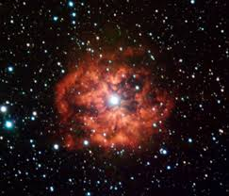
An object in the sky that sends out its own light, generated by nuclear reactions in its center

Slide 21
Star
An object in the sky that sends out its own light, generated by nuclear reactions in its center

