Slide 1
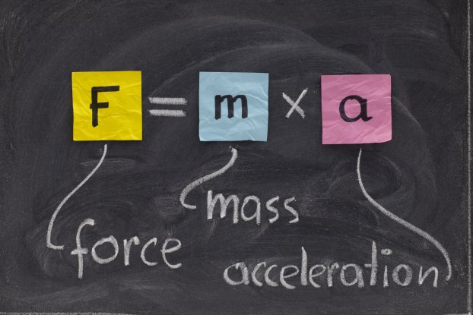
Law
A scientific law is a statement based on repeated experimental observations that describes some aspects of the universe.

Slide 2
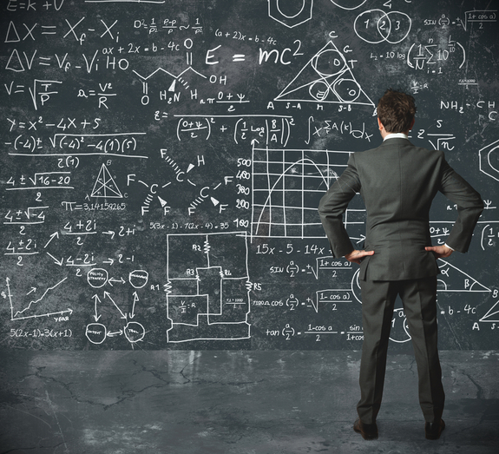
A well tested explanation for a wide range of observations or experimental results.
Scientific Theory

Slide 3
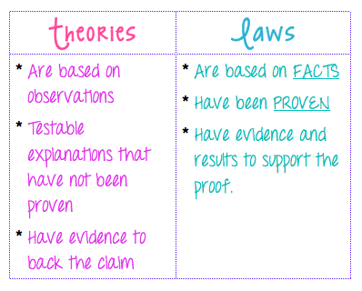

Slide 4
Meiosis
The process that occurs in the formation of sex cells by which the number of chromosomes is reduced.

Slide 5
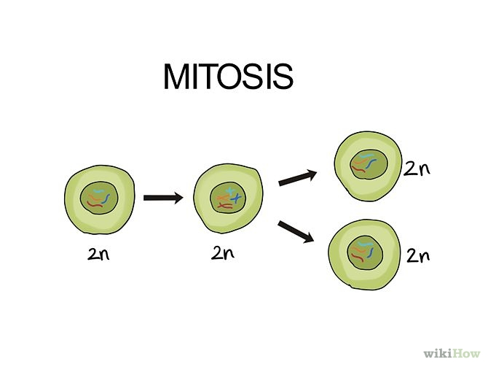
Mitosis
A type of cell division that results in two daughter cells each having the same number and kind of chromosomes as the parent nucleus, typical of ordinary tissue growth.

Slide 6
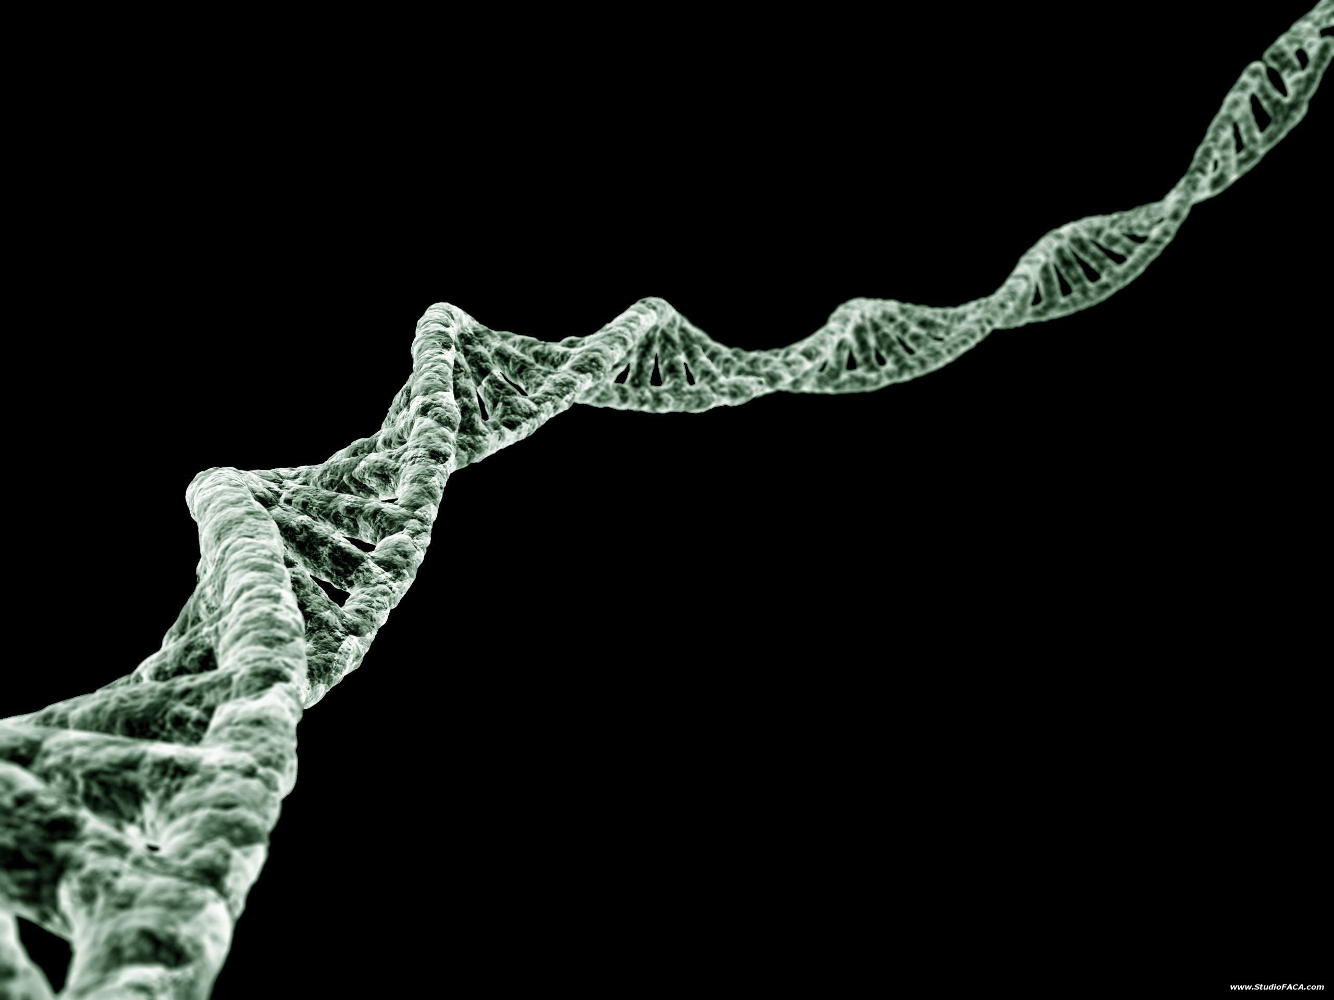
The different forms of a gene.
Allele
The different forms of a gene.

Slide 7
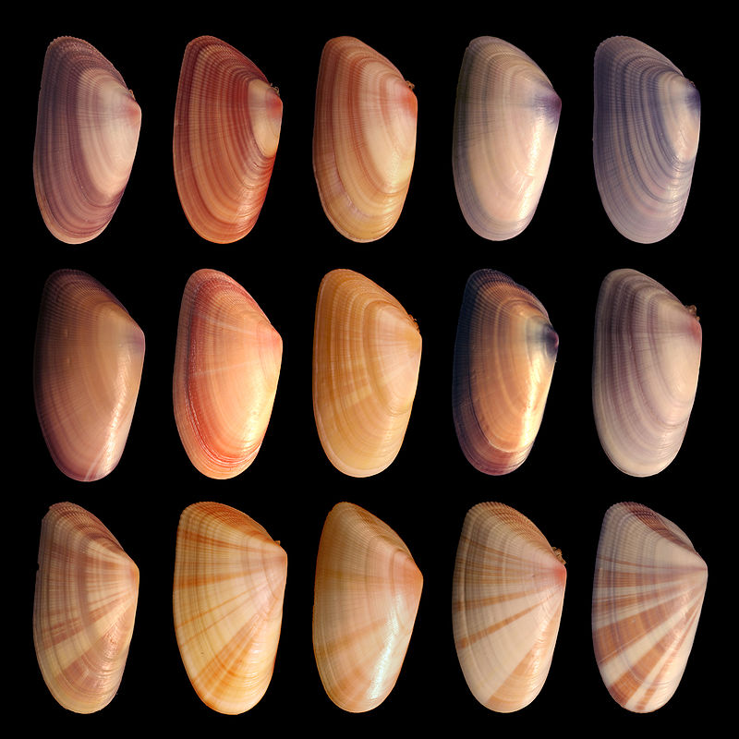
Phenotype
An organism’s physical appearance or visible traits.

Slide 8
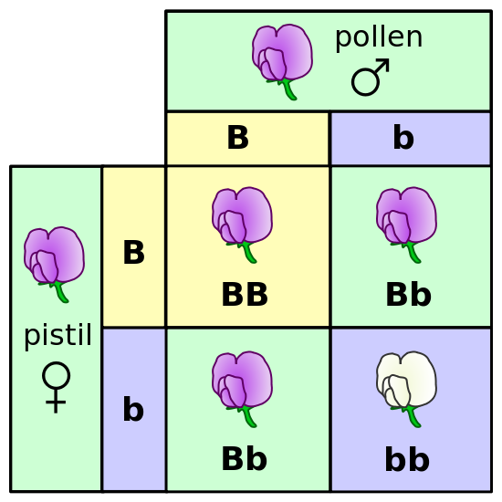
Genotype
An organism’s genetic makeup or allele combinations.

Slide 9
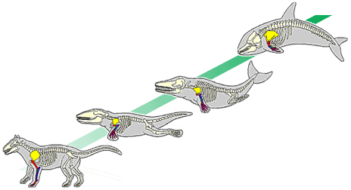
Evolution
Change over time.

Slide 10
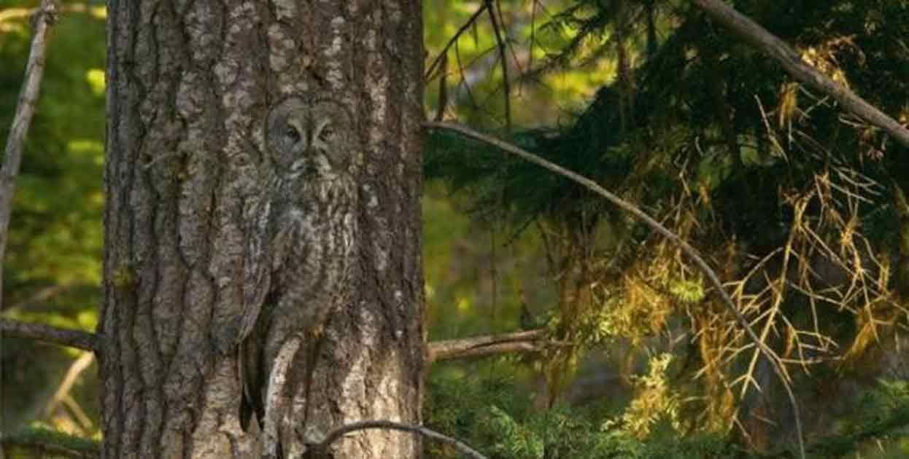
Adaptation
An inherited behavior or physical characteristic that helps an organism survive and reproduce in its environment.

Slide 11
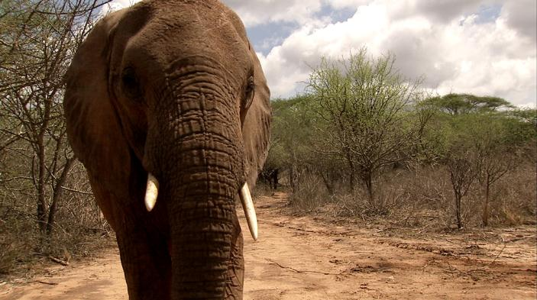
Threatened Species
A species that could become endangered in the near future.

Slide 12
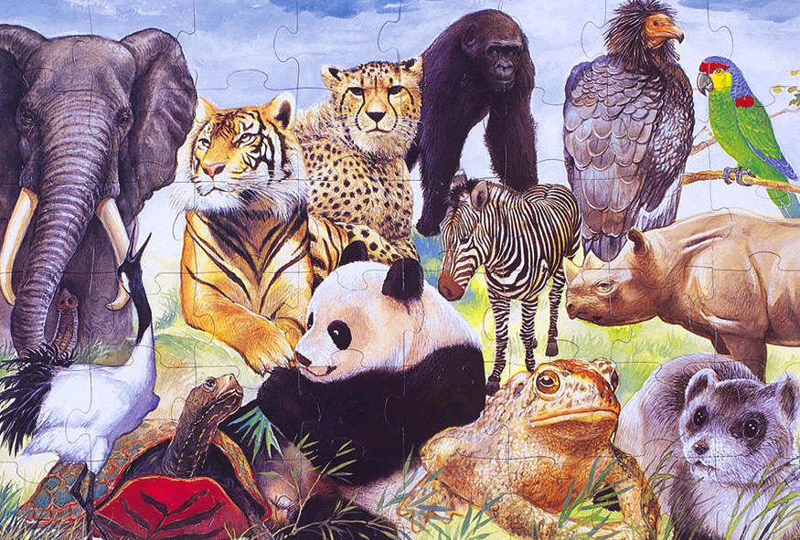
Endangered Species
A species in danger of becoming extinct in the near future.

Slide 13
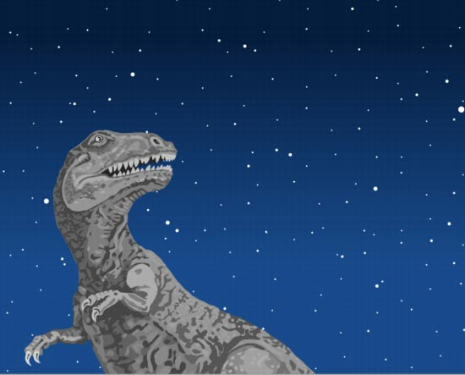
Extinct
Refers to a group of related organisms that has died out and has no living members.

Slide 14
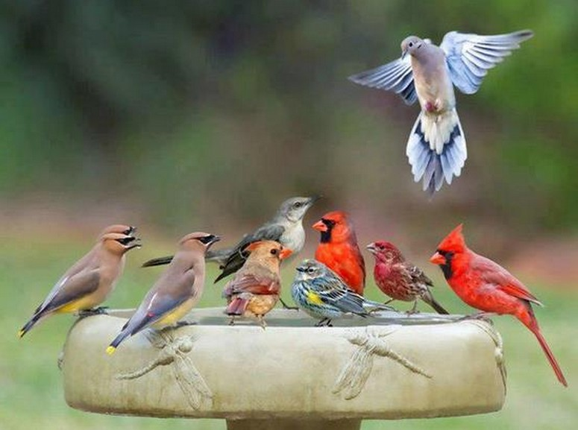
Community
All the different populations that live together in a particular area.

Slide 15
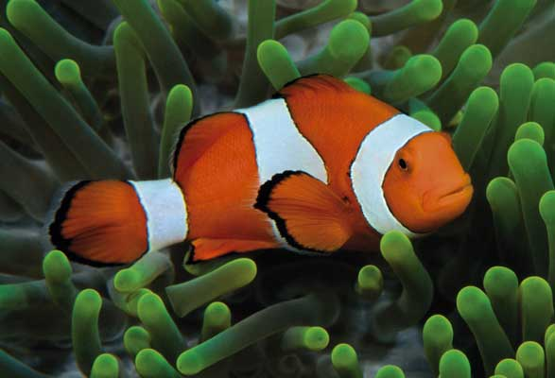
Niche
How an organism makes its living and interacts with the biotic and abiotic factors in its habitat.

Slide 16
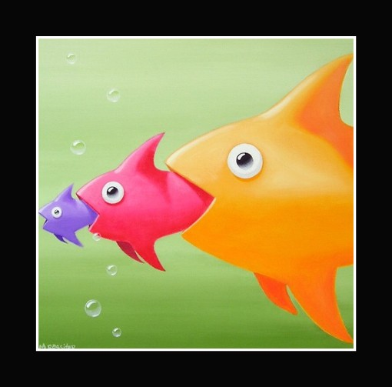
Food Chain
A series of events in an ecosystem in which organisms transfer energy by eating and by being eaten.

Slide 17
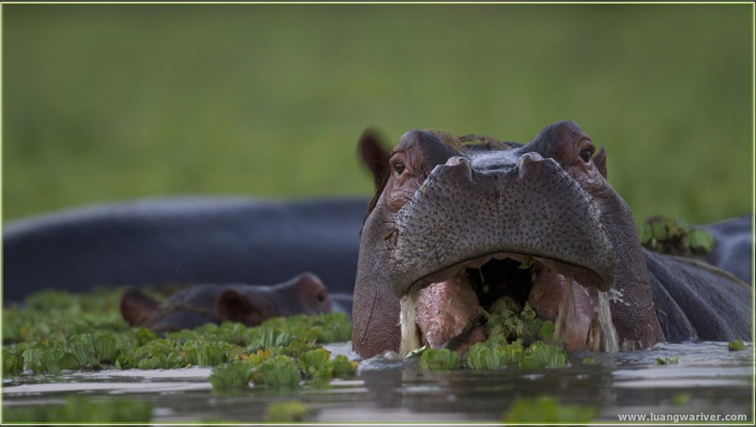
Herbivore
A consumer that obtains energy by eating only plants.

Slide 18
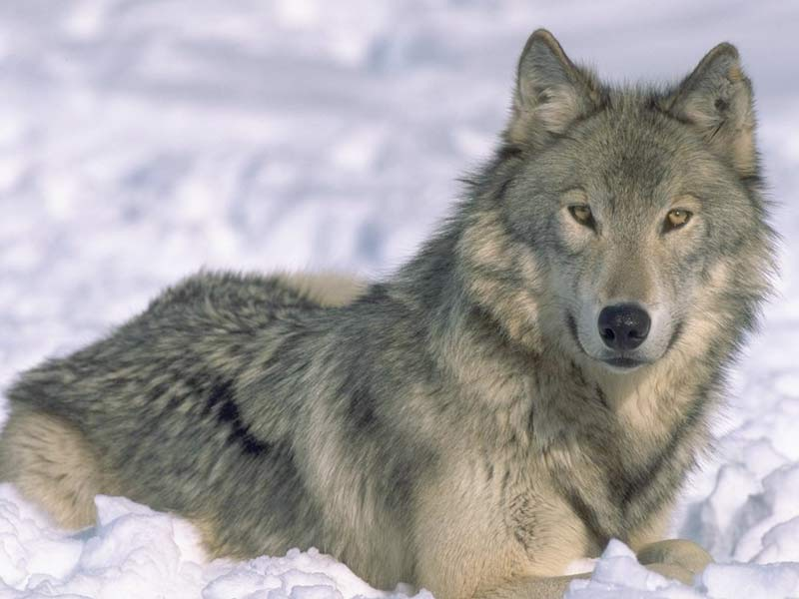
Carnivore
A consumer that obtains energy by eating only animals.

Slide 19
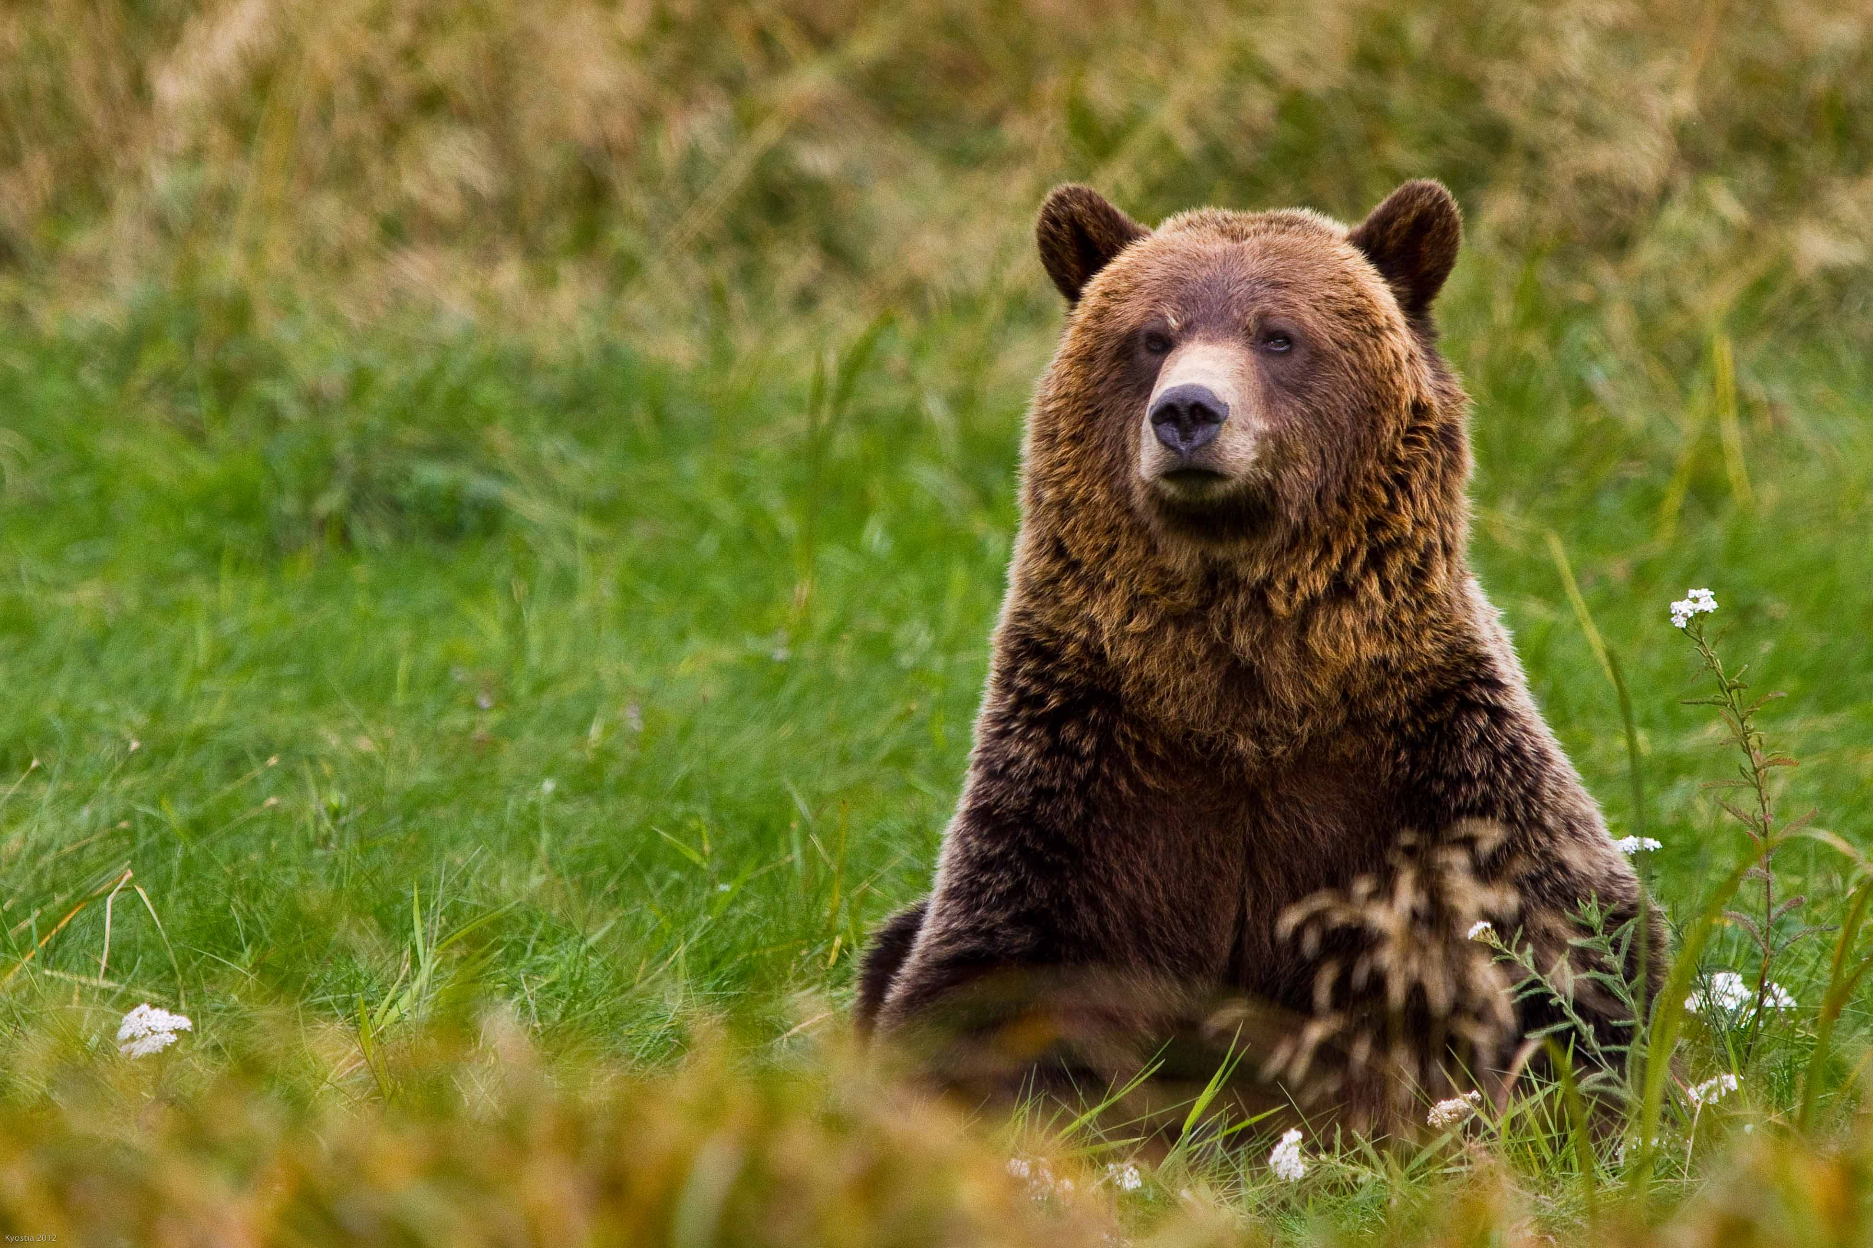
Omnivore
A consumer that obtains energy by eating both plants and animals.

Slide 20
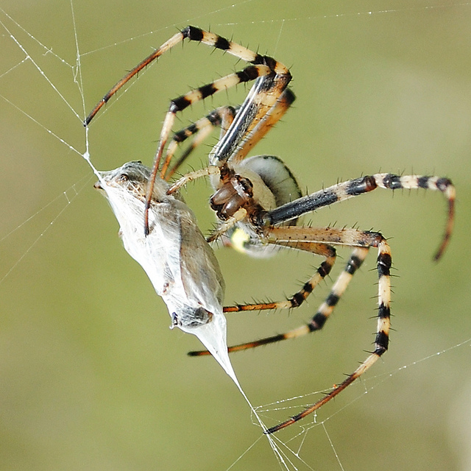
Predator
The organism that does the killing in a predation interaction.

Slide 21
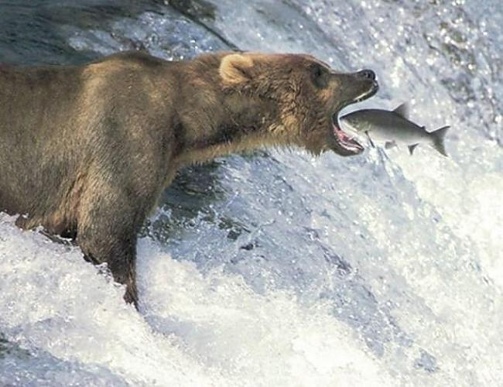
Prey
An organism that is killed and eaten by another organism in a predation interaction.

