Slide 1
Earth and Space Science
Quiz #3- Monday’s Vocabulary

Slide 2
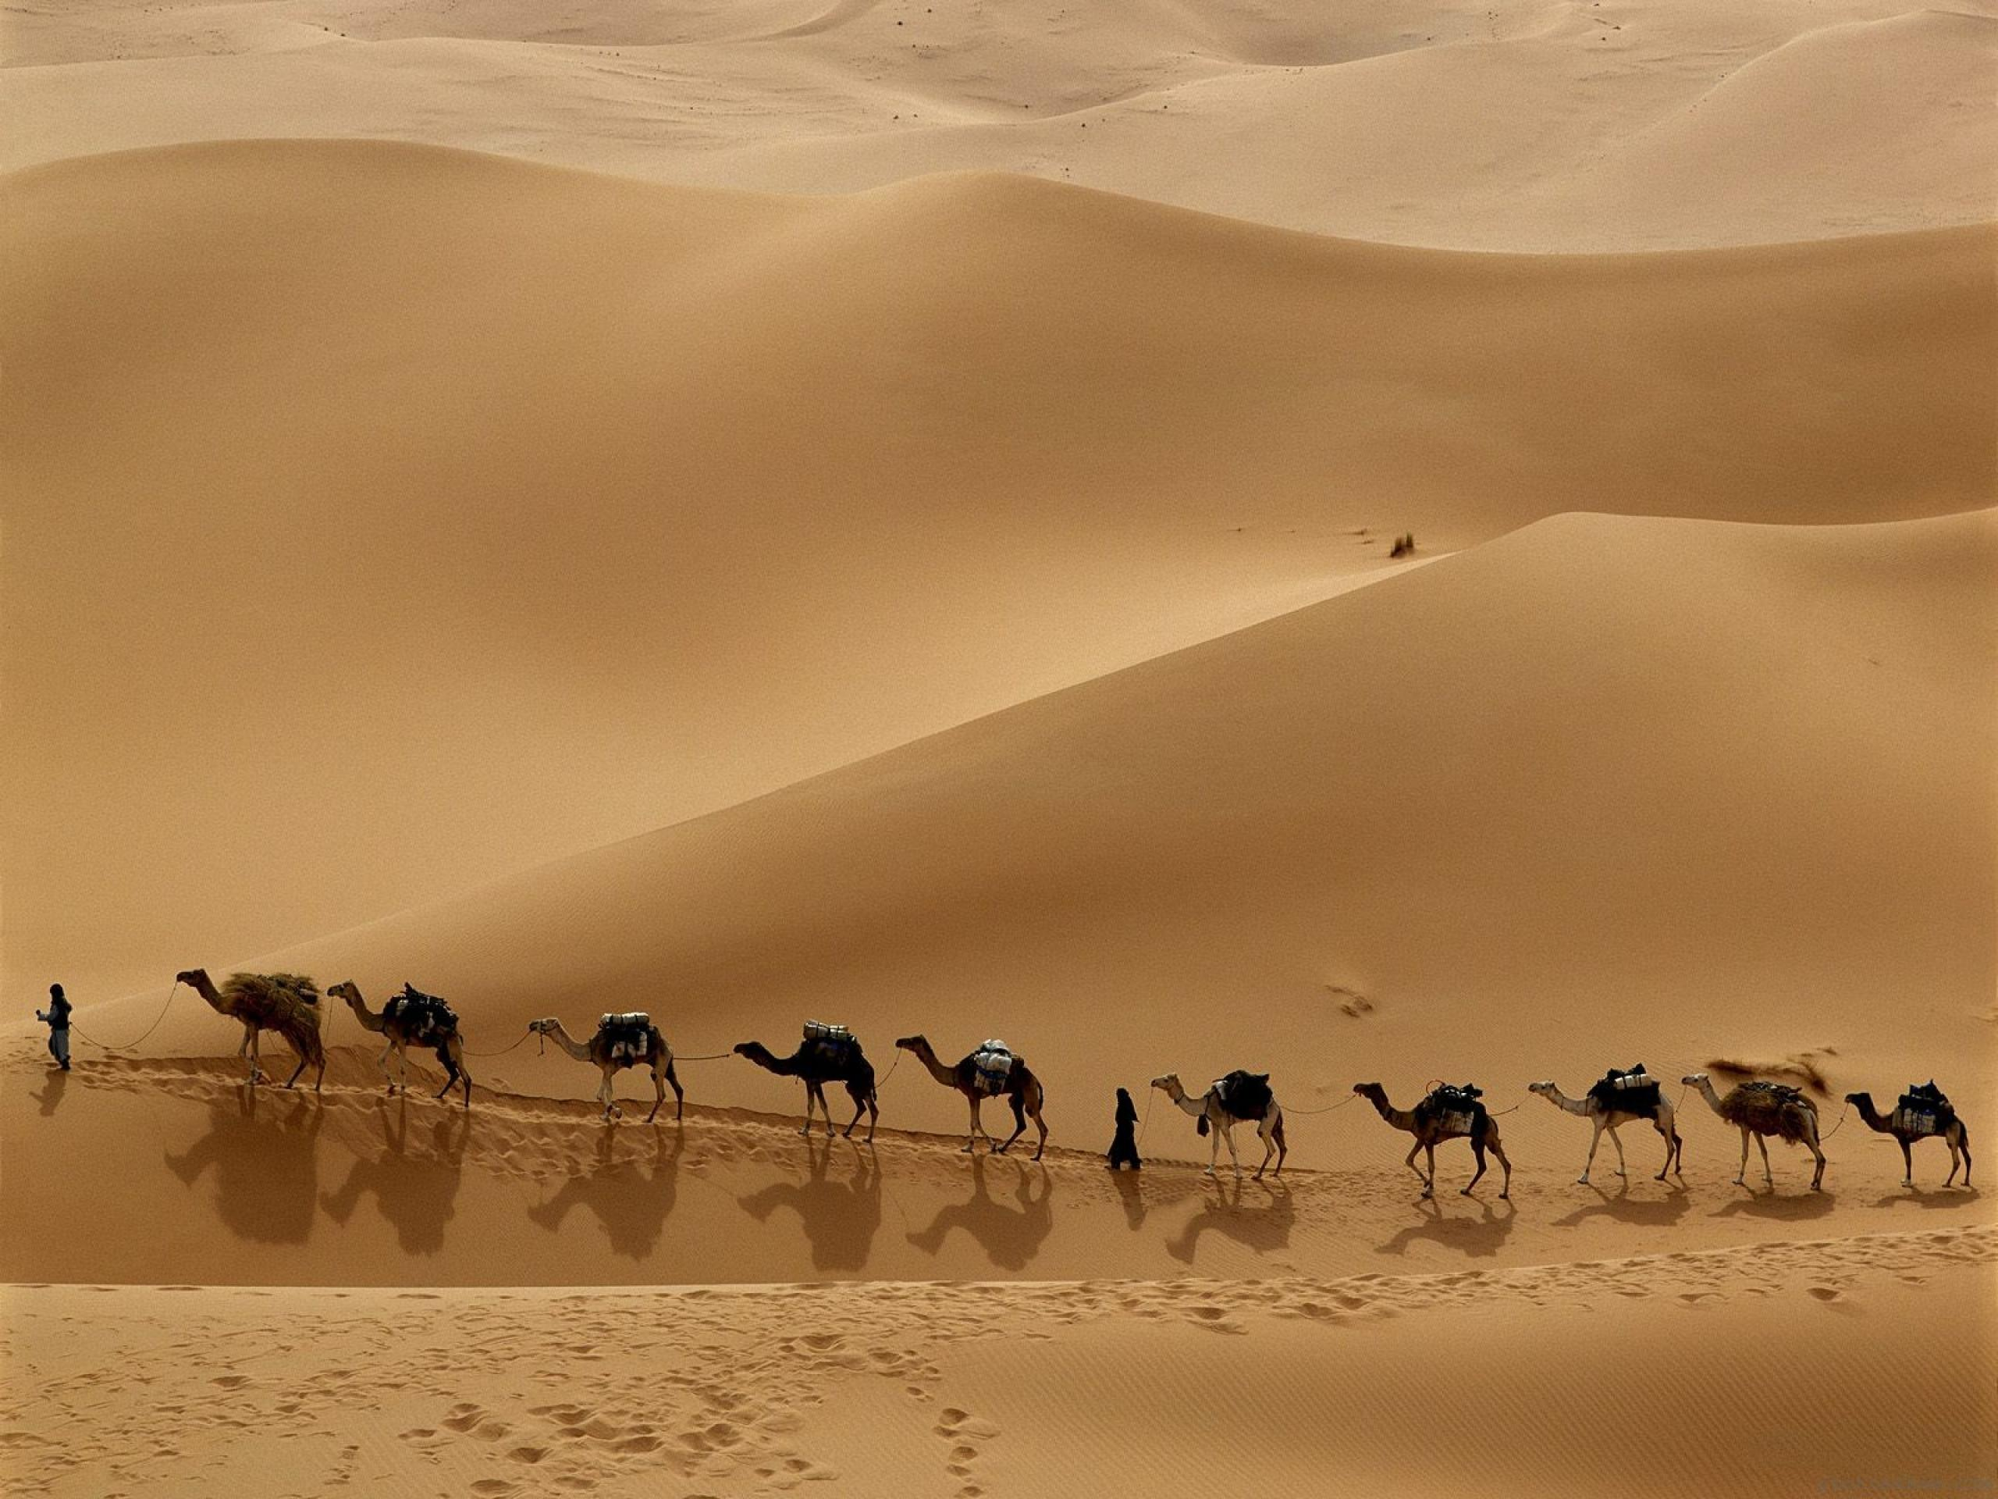
Temperature
A measure of the average energy of motion of the particles of a substance.

Slide 3
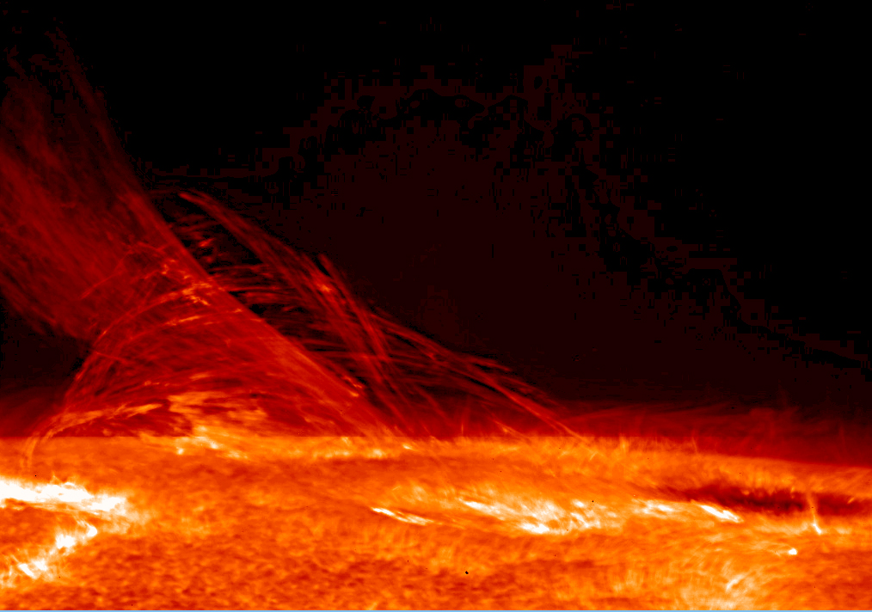
Heat
The transfer of thermal energy from a warmer object to a cooler object.

Slide 4
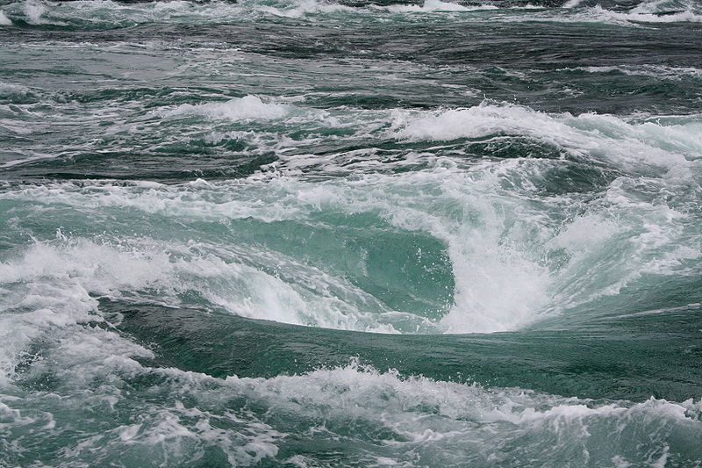
Convection
The transfer of thermal energy by the movement of a fluid.

Slide 5
Radiation
The transfer of energy by electromagnetic waves.

Slide 6
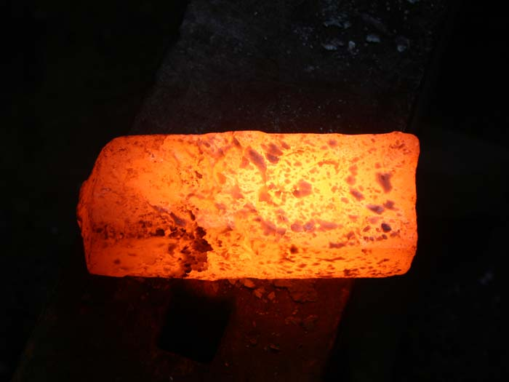
Conduction
The transfer of thermal energy from one particle of matter to another.

Slide 7
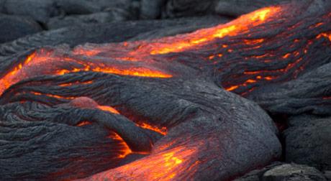
Igneous Rock
A type of rock that forms from the cooling of molten rock at or below the surface.

Slide 8
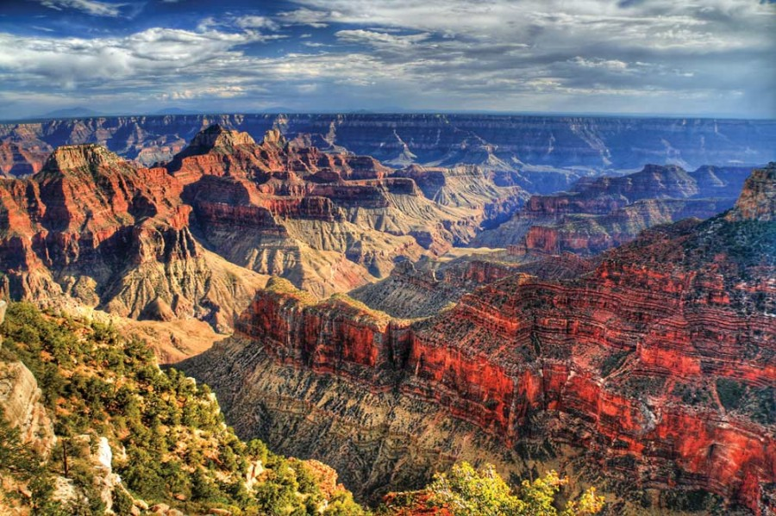
Sedimentary Rock
A type of rock that forms when particles from other rocks or the remains of plants and animals are pressed and cemented together.

Slide 9
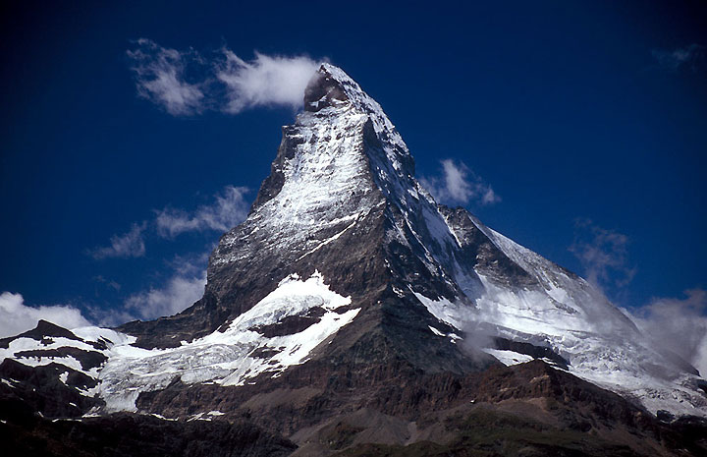
A type of rock that forms from an existing rock that is changed by heat, pressure, or chemical reaction.
Metamorphic
Rock

Slide 10
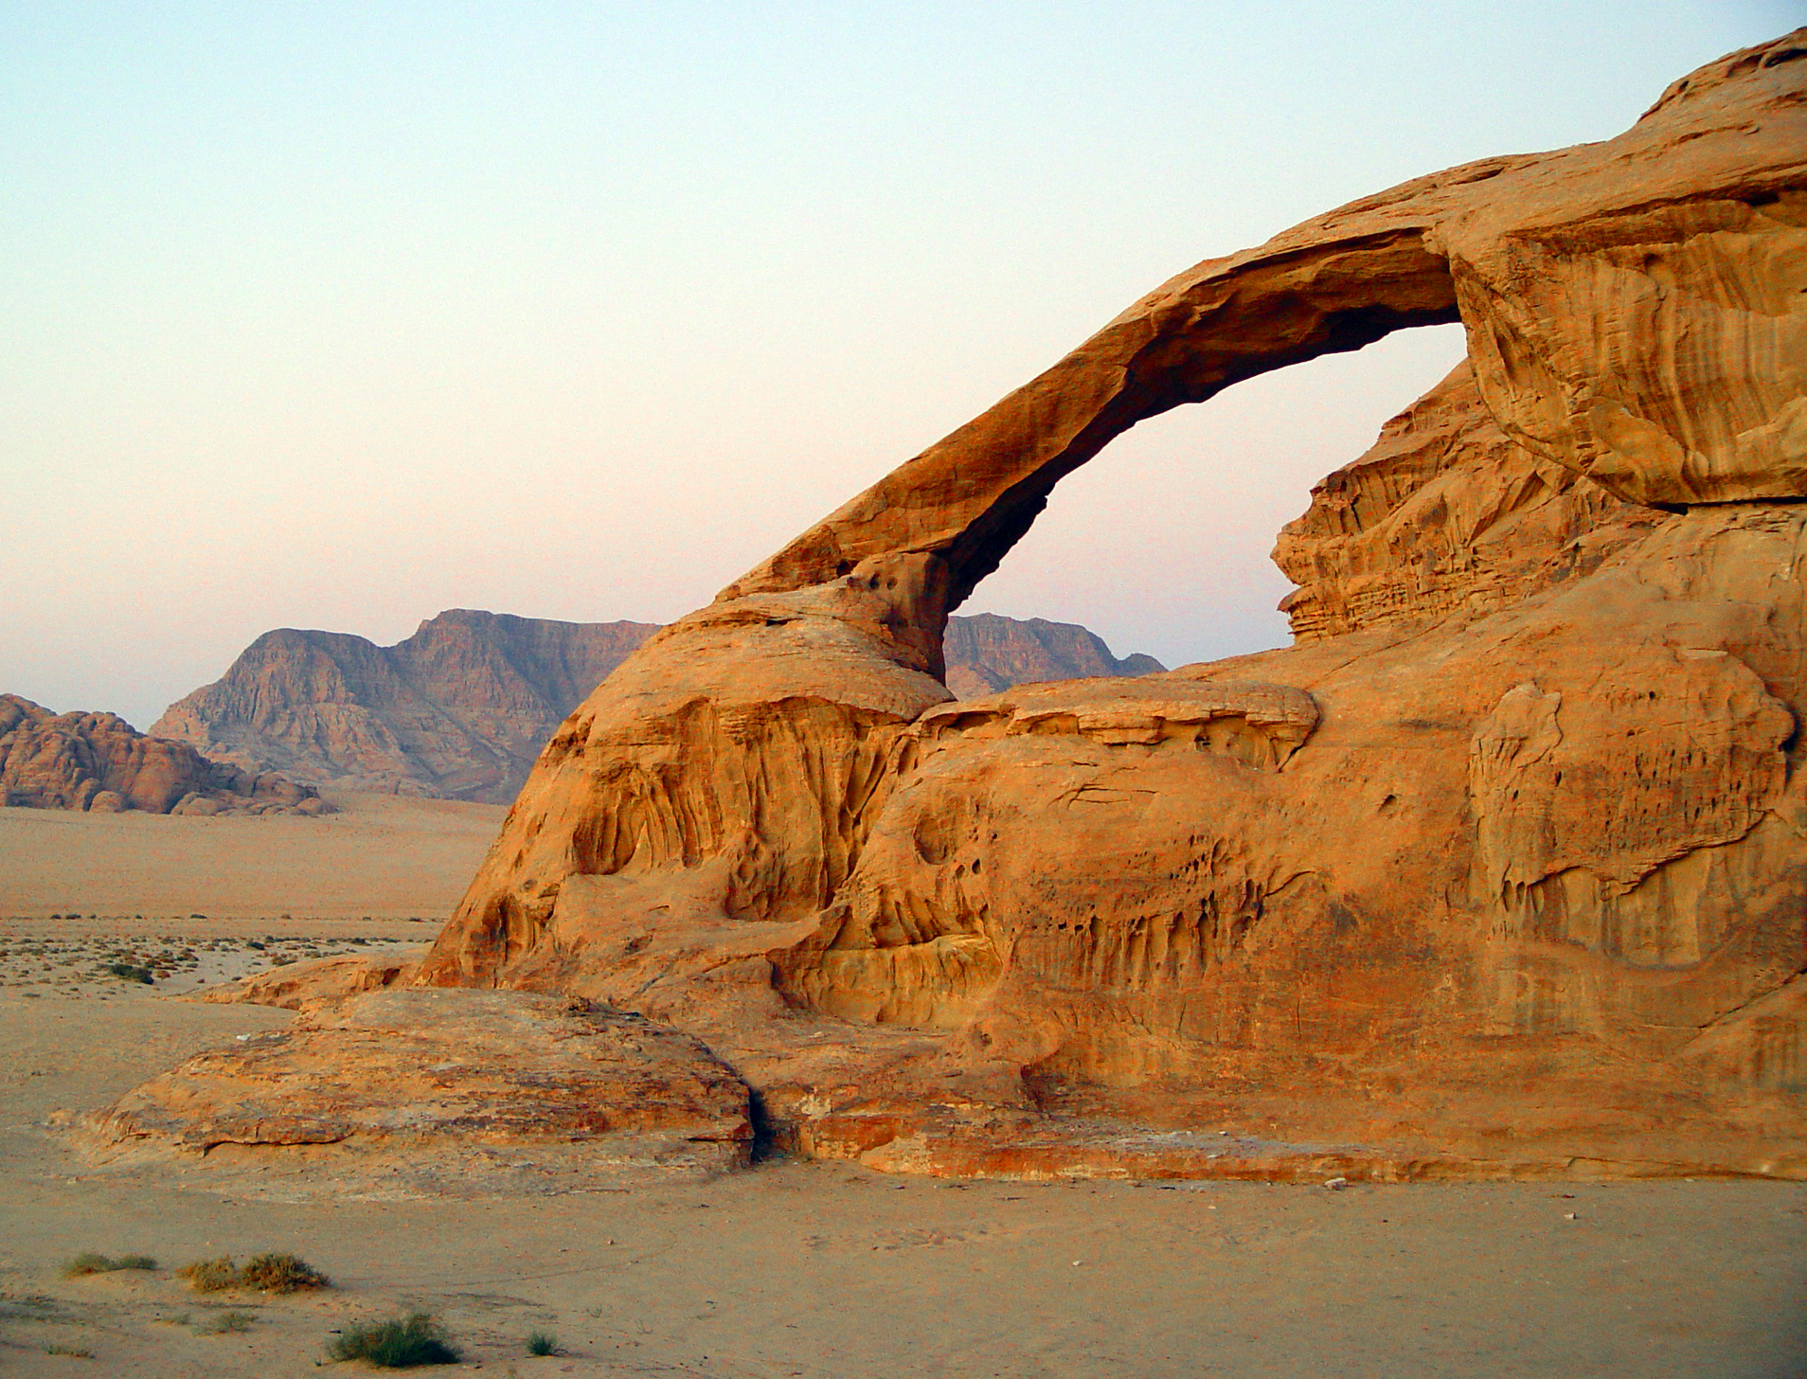
Weathering
The chemical and physical processes that break down rock and other substances.

Slide 11
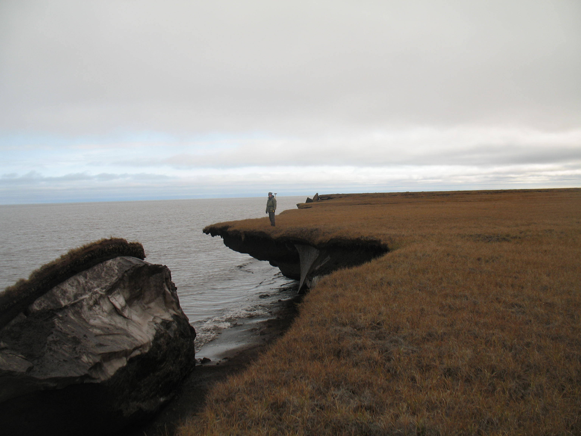
Erosion
The process by which water, ice, wind, or gravity moves weathered particles of rock and soil.

Slide 12
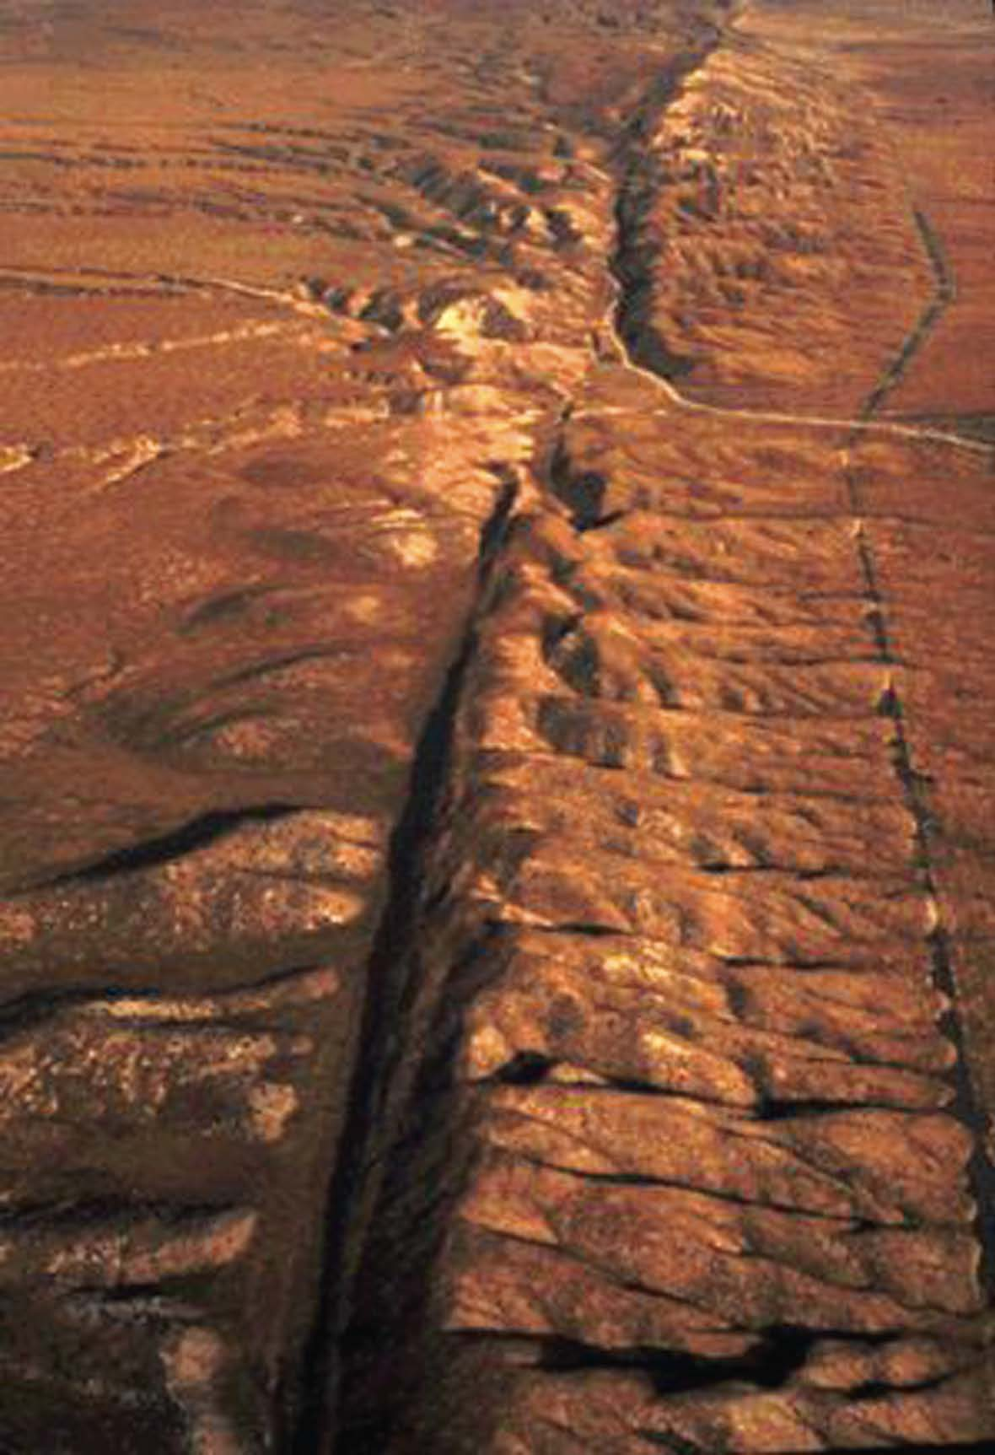
Fault
A break in Earth’s crust along which rocks move.

Slide 13
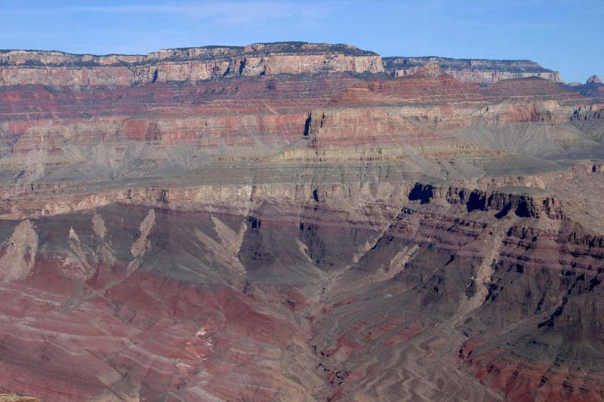
Unconformity
A gap in the geologic record that shows where rock layers have been lost due to erosion.

