Slide 1
The Nature of Science ?

Slide 2
Observing
The process of using one or more of your senses to gather information.

Slide 3
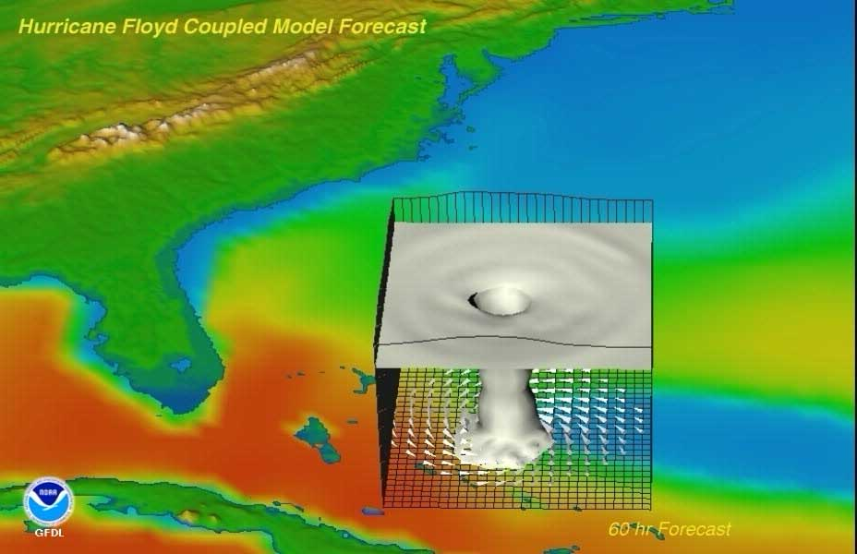
Models
A replica or description designed to show the workings or structure of an object or system.

Slide 4
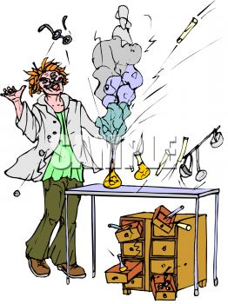
Variable
A factor that can be changed
in an experiment.

Slide 5
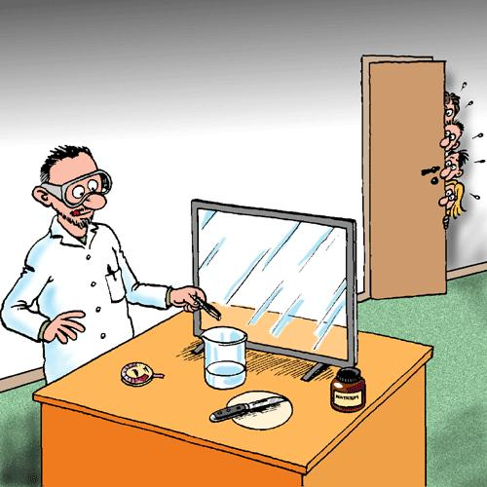
Independent Variable
The one factor that a scientist changes during an experiment.

Slide 6
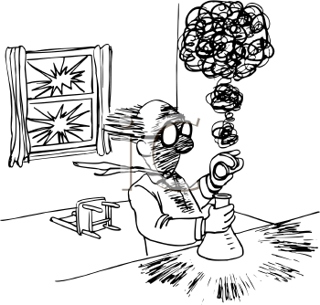
Dependent
Variable
The factor that changes as a result of changes to the independent variable in an experiment.

Slide 7
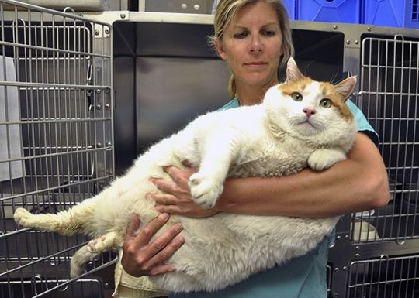
Mass
A measure of how much matter is in an object.

Slide 8
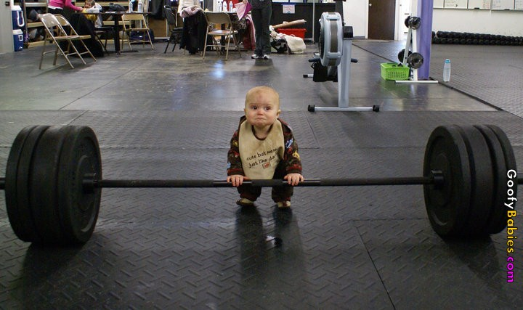
Weight
A measure of the force of gravity acting on an object.

Slide 9
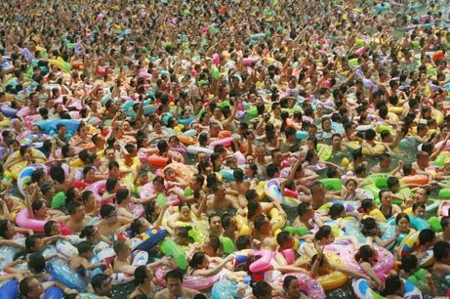
Volume
The amount of space that matter occupies.

Slide 10
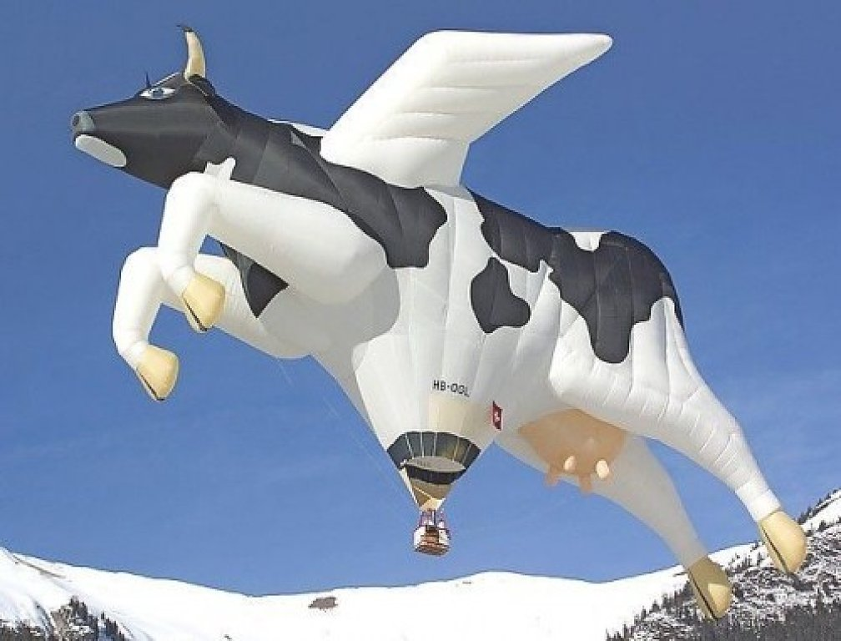
Density
The measurement of how much mass of a substance is contained in a given volume.

Slide 11
Matter
Anything that has mass and takes up space.

Slide 12
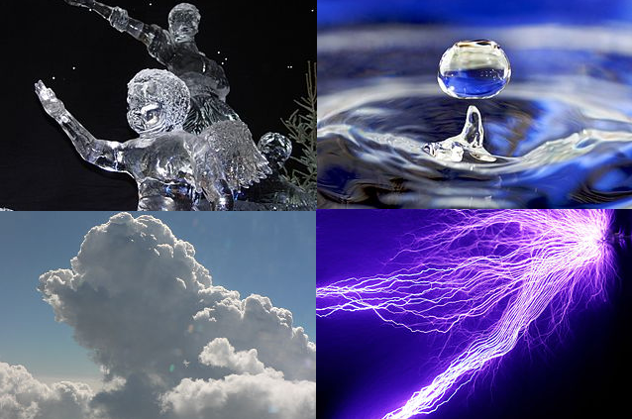
State of Matter
The form in which matter exists.

Slide 13
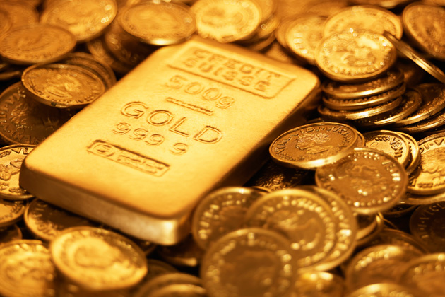
A state of matter that has a definite shape and a definite volume.
Solid

Slide 14
Liquid
A state of matter that has no definite shape but has a definite volume.

Slide 15
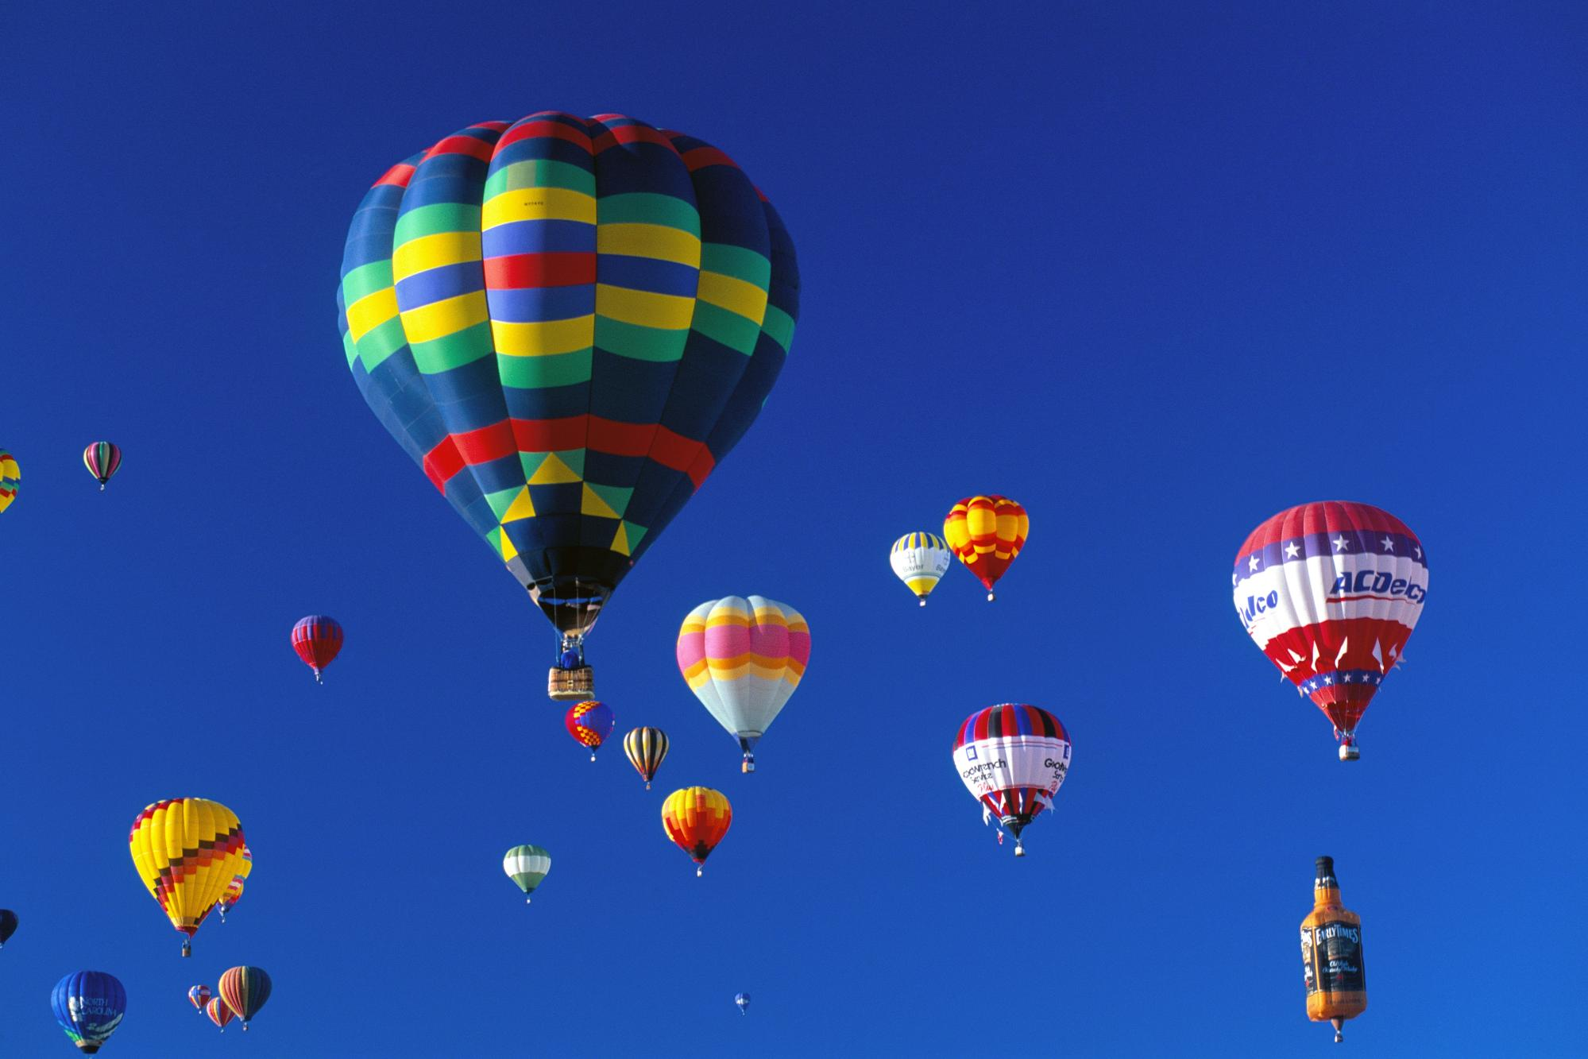
Gas
A state of matter with no definite shape or volume.

