Slide 1
One physical property of a star is apparent magnitude. Which of the following is used in determining the apparent magnitude of a star? A. the constellation the star is in B. the distance the star is from Earth C. the number of times the star rotates D. the number of prominences the star makes

Slide 2
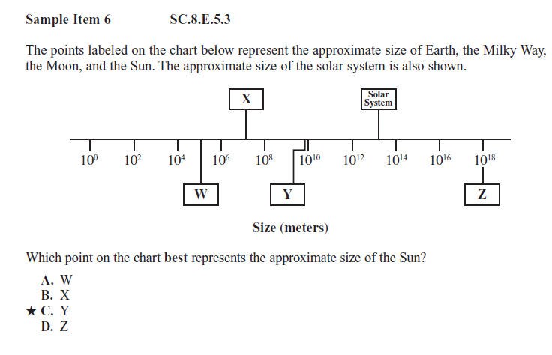

Slide 3
Scientific knowledge may change as new evidence or information is discovered. Which of the following would NOT be a result of new scientific research and information? A. Binomial nomenclature is assigned to a recently identified plant species. B. An endangered monkey species is put in a reserve for protection from extinction. C. A newly discovered chemical element will be added to the periodic table of the elements. D. A nonnative plant species will begin to reproduce rapidly after being introduced into a swamp ecosystem.

Slide 4
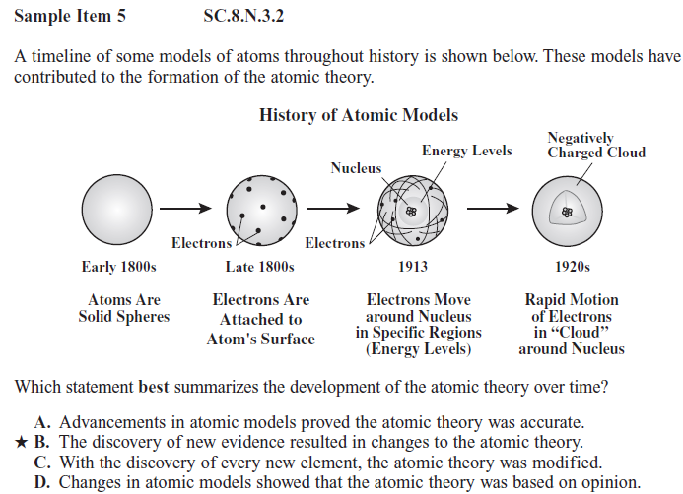

Slide 6
